Slide 1


Road Networking using Graph in Data Structure
Graphs are a powerful data structure used to model and analyze complex networks, including road systems. By representing roads as nodes and intersections as edges, we can leverage graph algorithms to optimize routing, identify traffic patterns, and plan infrastructure improvements.
by Vaishnavi

Slide 2

What is a Graph?
1
Nodes
2
Edges
3
Weighted Edges
Represent key points in a network, such as intersections or landmarks.
Connections between nodes, representing roads, paths, or relationships.
Edges can have associated weights, like distance or travel time, to model real-world attributes.

Slide 3
Representing Graphs in Memory
Adjacency Matrix
Adjacency List
Tradeoffs
A 2D array where each cell indicates the presence or weight of an edge between two nodes.
A collection of lists, where each list contains the neighboring nodes for a given node.
Adjacency matrices are space-efficient for dense graphs, while adjacency lists are better for sparse graphs.

Slide 4
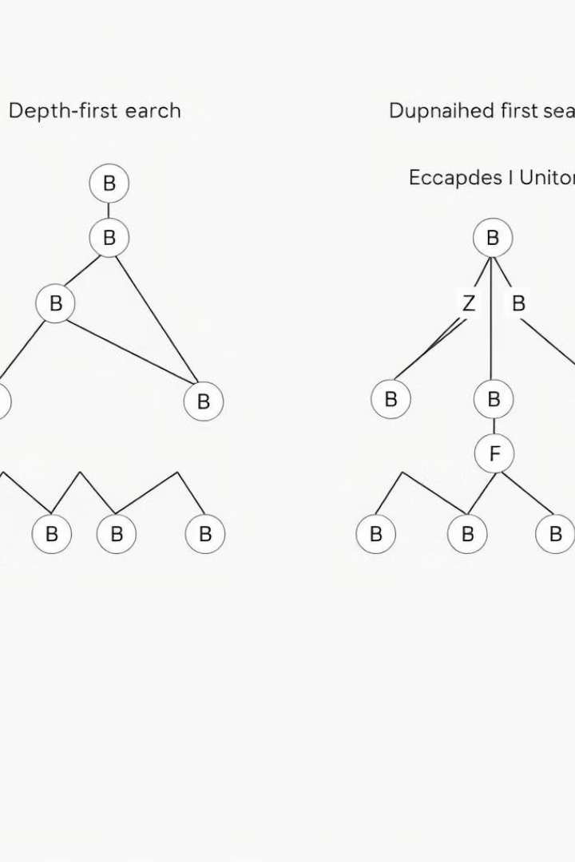
Traversal Algorithms: Depth-First Search (DFS) and Breadth-First Search (BFS)
1
DFS
Explores a graph by going as deep as possible along each branch before backtracking.
2
BFS
Explores a graph by visiting all the neighboring nodes at the present depth before moving on to the nodes at the next depth level.
3
Applications
DFS is useful for finding connected components, while BFS is better for finding shortest paths.

Slide 5
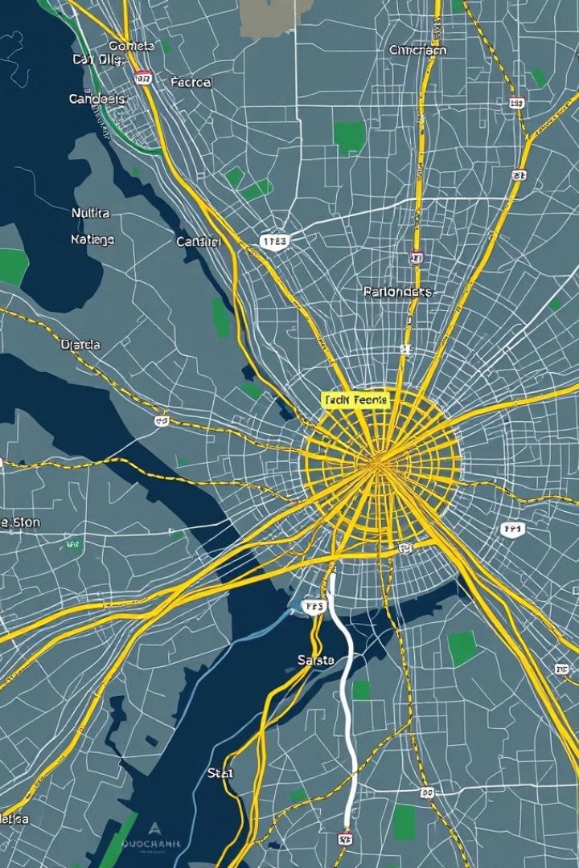
Applications of Graph Networks in Road Mapping
Routing Optimization
Traffic Analysis
Finding the shortest or fastest path between two points using algorithms like Dijkstra's or A*.
Identifying congestion hotspots, predicting travel times, and managing traffic flow.
Infrastructure Planning
Navigation Systems
Analyzing network connectivity, identifying bottlenecks, and planning new road construction.
Providing users with turn-by-turn directions and real-time updates on road conditions.

